Slide 1
ICY THERAPY spot treats CANCER in the lung

Slide 2
Evaluating Cryoablation of Metastatic Lung/Pleura Tumors In Patients –
Safety and Efficacy
ECLIPSE
de Baere T¹ ; Woodrum D² ; Abtin F³ ; Littrup P⁴ ; Farouil G¹
1. Institut de Cancerologie Gustave Roussy, VILLEJUIF Cedex, France
2. Mayo Clinic, Rochester, MN, United States
3. Unv. of California-Los Angeles, Los Angeles, CA, United States
4. Karmanos Cancer Institute, Detroit, MI, United States

Slide 3
Multicenter, prospective, single arm study
Dr. Thierry de Beare
Institut de Cancerologie Gustave Roussy, VILLEJUIF Cedex, France
2. Dr. David Woodrum
Mayo Clinic,
Rochester, MN, United States
3. Dr. F Abtin
Unv. of California-Los Angeles,
Los Angeles, CA, United States
4. Dr. Peter Littrup
Karmanos Cancer Institute,
Detroit,MI, United States

Slide 4
Objective
Assess the role of CT guided cryoablation in targeted treatment of small to medium metastatic tumors in the lung

Slide 5
Why Ablation versus Surgery
Many of the patients are not surgical candidates
Cryoablation usually requires only an overnight stay in the hospital
Shorter recovery time

Slide 6
Inclusion Criteria
Pulmonary metastatic disease
Up to 5 pulmonary metastases (≤3.5 cm) with no more than 3 on one side.

Slide 7
Exclusion Criteria
Primary NSLC lung cancer
Inability to lie flat or respiratory distress at rest
Uncontrolled coagulopathy or bleeding disorders

Slide 8
Demographics
Age
Min: 26
Avg: 63
Max: 83
BMI
Min: 15
Avg: 27
Max: 44

Slide 9
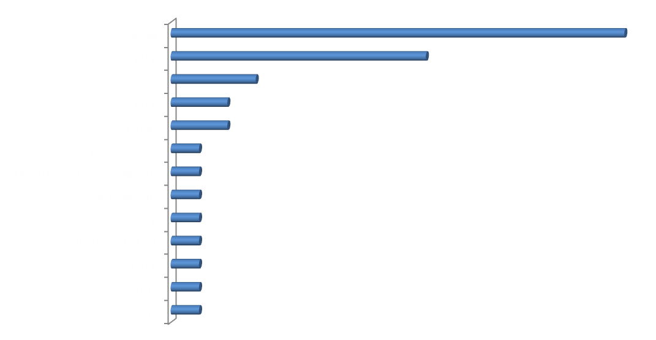
Primary Cancer Diagnosis

Slide 10
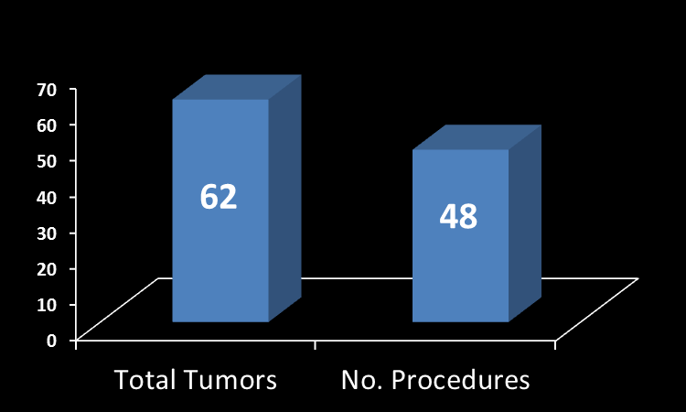
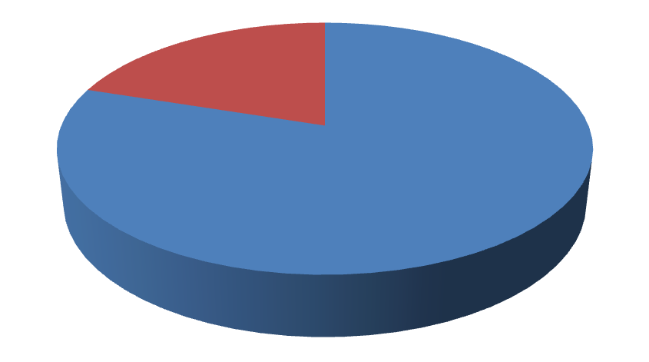
Procedure Data
Tumor Size (cm)
Min: 0.3
Avg: 1.4
Max: 3.2
Tumor Locations
Bilateral
20%
Unilateral
80%
Confidential
10

Slide 11
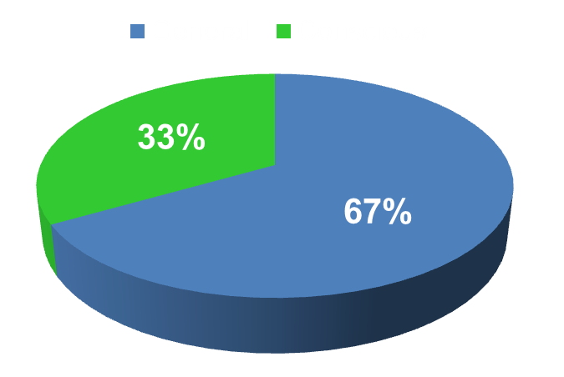
Procedure Data
Confidential
11

Slide 12
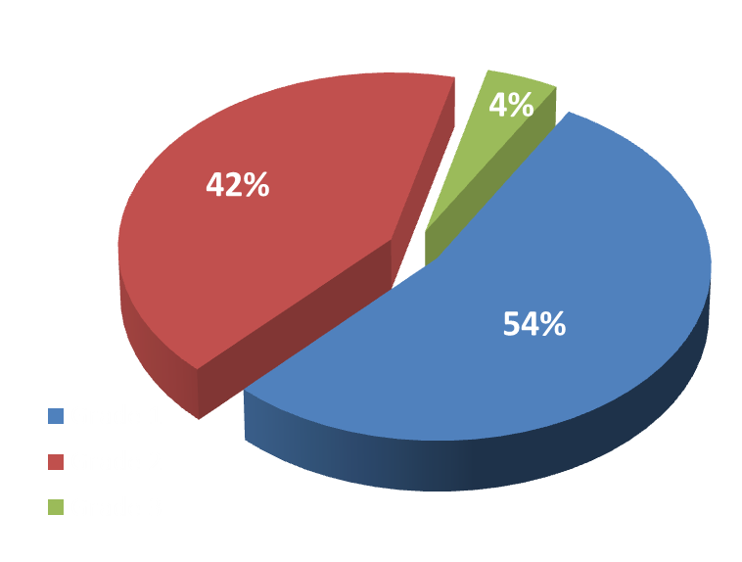
Side Effects
CTCAE Grade
Top Five
Adverse Event
Number
Rate Per Procedure
Pneumothorax
Pleural Effusion
Pain: Chest/Back
Hemorrhage
Cough
24
10
6
4
3
50%
21%
13%
8%
6%
Grade 3 Events
Non-Cardiac Chest Pain
Pneumothorax requiring VATS
AV Fistula thrombosis requiring thrombectomy
Confidential
12

Slide 13
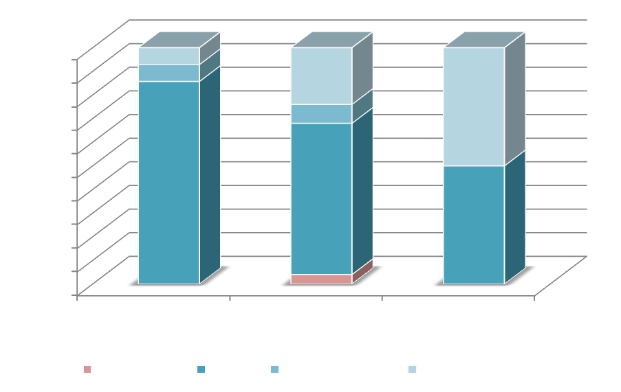
Response Rate
100%
95%
100%

Slide 14
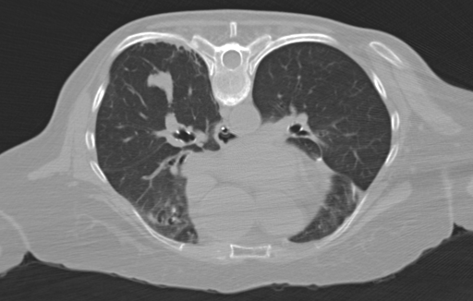
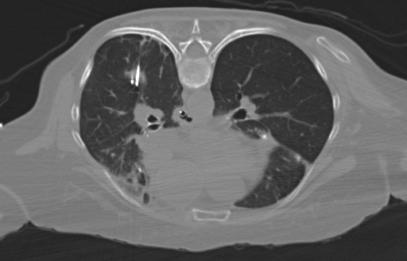
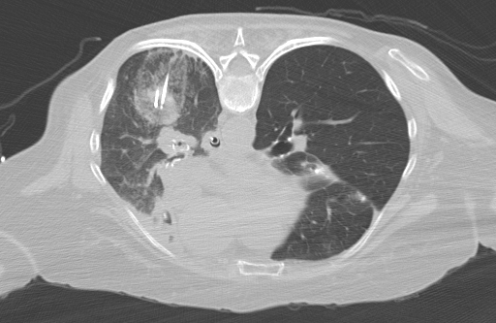
Lung Cryoablation
Lung Metastasis
Axial Probe Placement
Needles
In
Tumor
Lung
Tumor
Coronal Probe Placement
Freezing
Ice Ball
Edge

Slide 15
Take Home Points
Cryoablation of lung tumors mets ≤3.5 cm appears safe and efficacious
Preliminary short-term results offer promising local tumor control
Larger experience and longer follow-up is necessary

