Slide 1
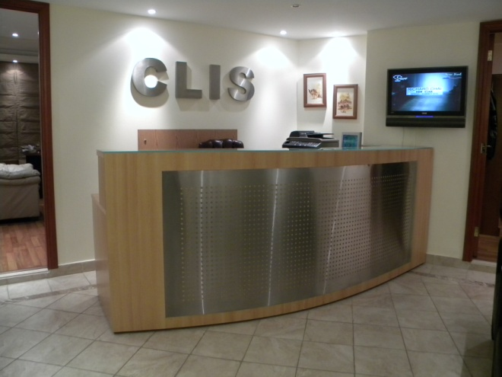
Laser Liposuction In Interventional Radiology
Abbas Chamsuddin, MD Maya Zayour, MD
The Center for Laser and Interventional Surgery CLIS

Slide 2
A new, minimally invasive treatment that uses lasers to melt fat could replace the “tummy tuck,” suggests our research on more than 2,000 people

Slide 3
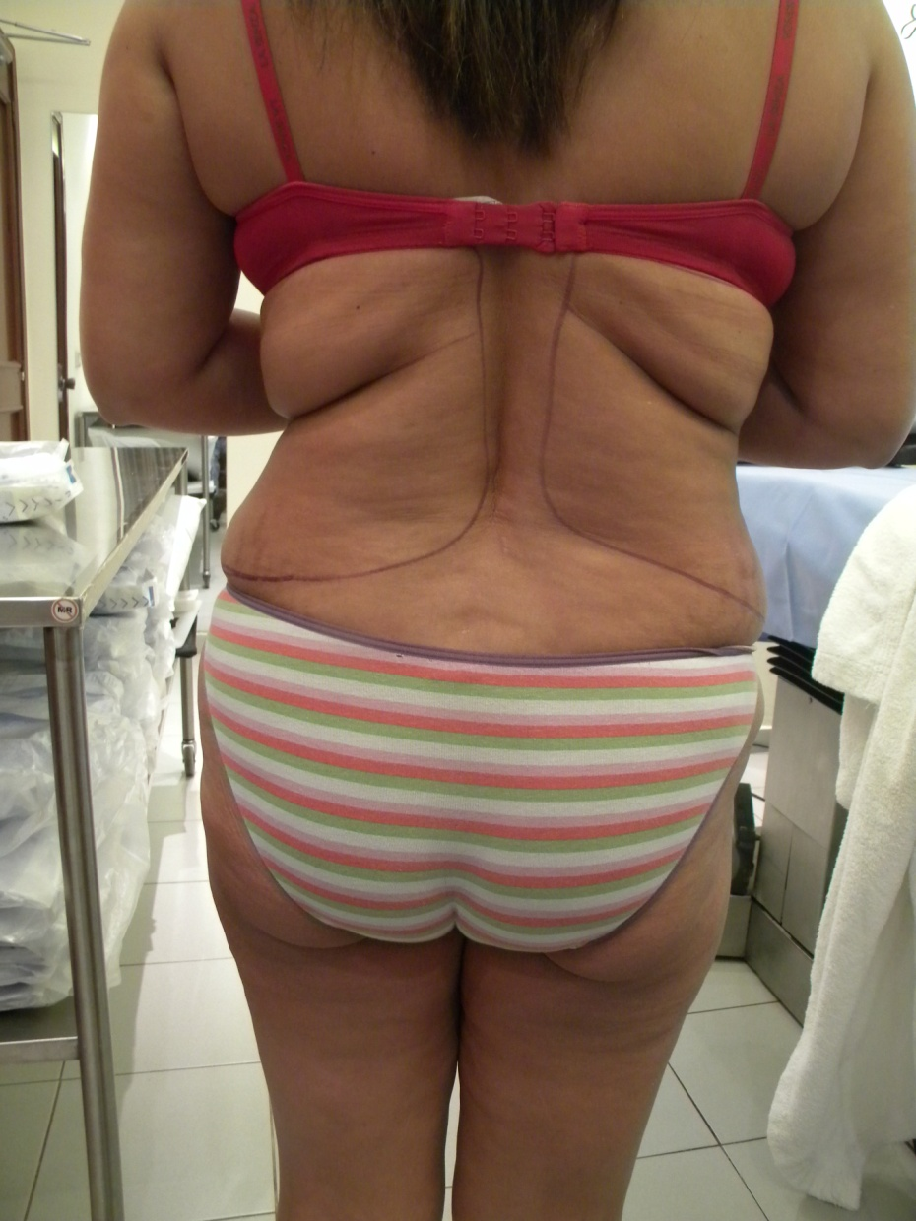
Laser Liposuction Before After

Slide 4
Laser lypolysis prompts collagen production, tightening skin and preventing it from sagging—unlike standard liposuction.

Slide 5
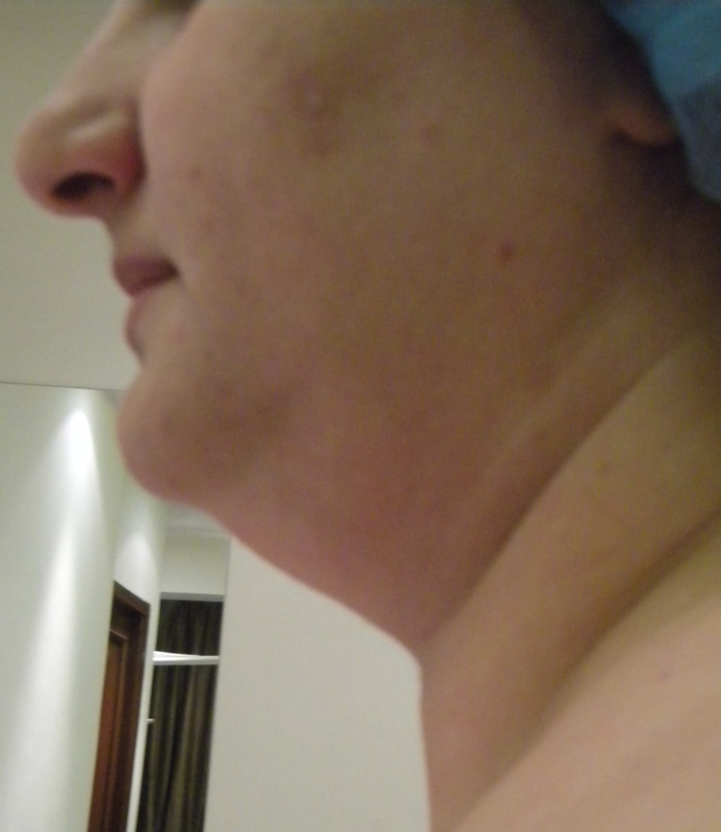
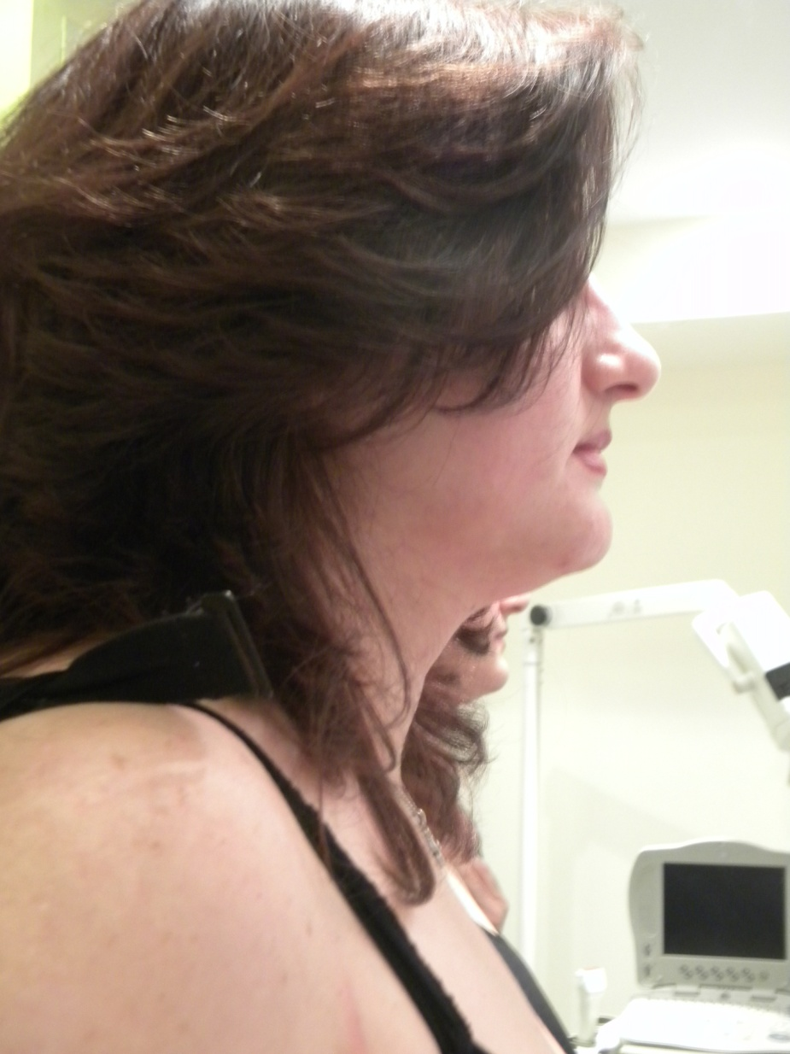
Laser Liposuction Before After

Slide 6
Used in combination with standard liposuction, laser lypolysis can remove fat and tighten skin without the risks of surgery.

Slide 7
Many people don’t try it because they have heard that the skin often sags after the fat is removed. This is especially true for individuals who want to lose abdominal fat, but also need the skin to retract. Traditional liposuction also has a limitation to the volume of fat that could potentially be removed. Combining traditional liposuction with laser lipolysis has now been shown to produce well-sculpted bodies with tight skin. We are able to give people things such as a tighter abdomen without the need for surgery

Slide 8
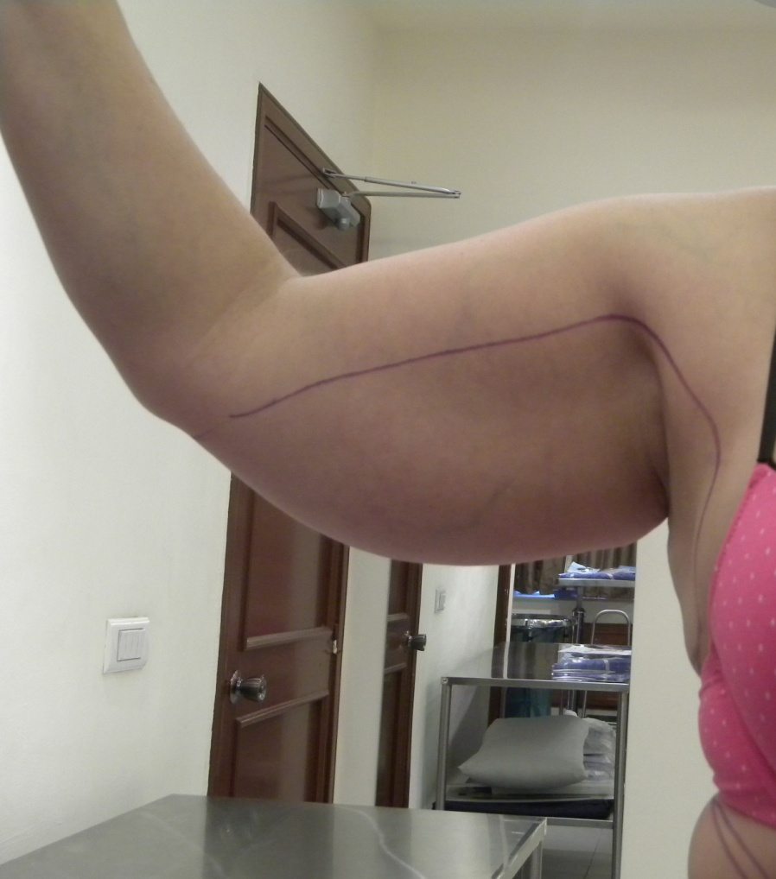
Laser Liposuction Before After

Slide 9
2,183 individuals, ages 17 to 73 (75 percent female, 25 percent male), underwent laser-assisted lipolysis and liposuction on multiple areas of the body, including the neck, arms, love handles, breast, belly, thighs and calves. Measurements were recorded including weight, diameter of the area treated and skin laxity. At follow-up appointment: the diameter of the treatment areas was measured and recorded. Skin tightness was also recorded against pre-procedure criteria.

Slide 10
Laser Liposuction Before After

Slide 11
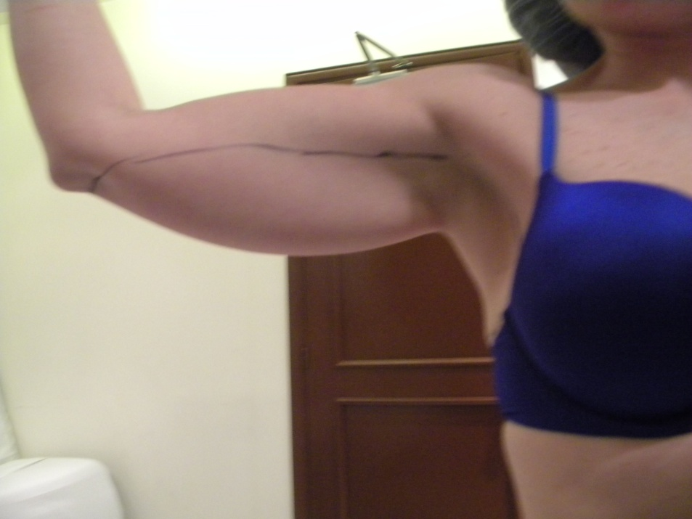
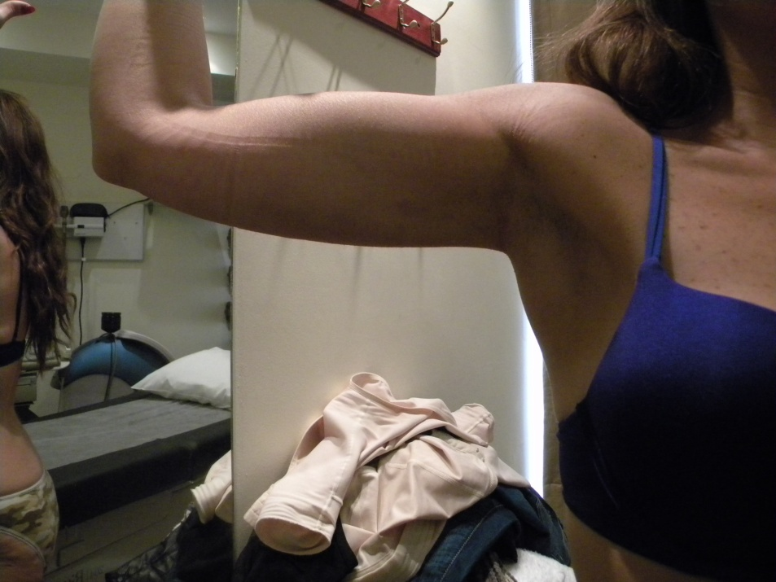
Laser Liposuction

Slide 12
The laser’s thermal (heat) energy melts the fat and standard liposuction removes it from the body. Patient follow-up was daily for a week and then at one, three and six months. All treated areas showed improvement in reducing fat bulk as well as tightening skin. The laser uses targeted energy to “zero in” on the fat, without affecting the other tissue, enabling a faster recovery

Slide 13
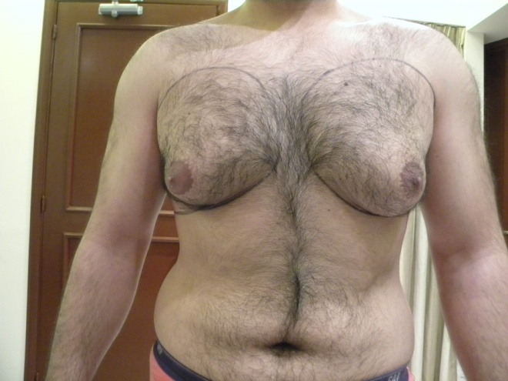
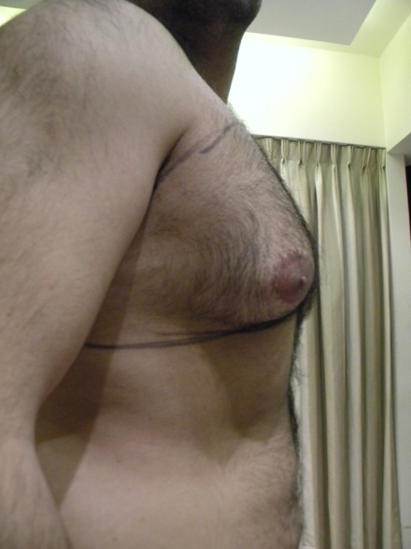
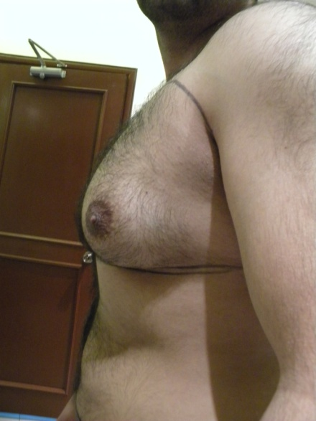
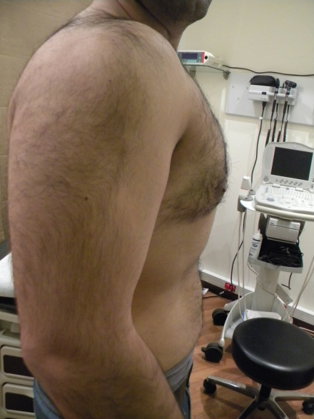
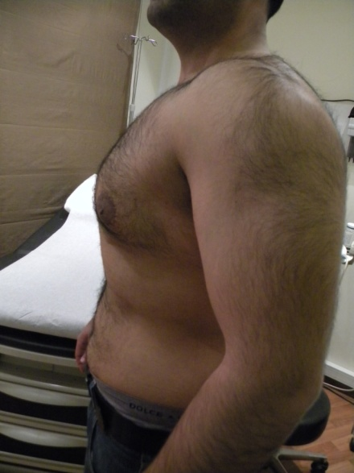
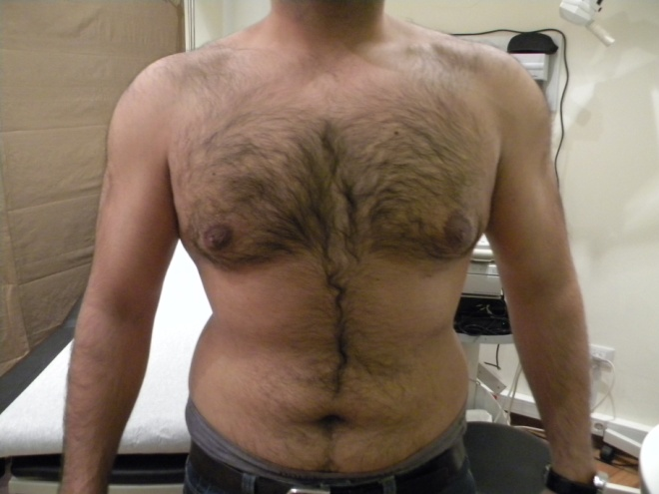
Laser Liposuction

Slide 14
Interventional radiology treatments are an advance in medicine that generally replace open surgery and offer less risk, less pain and less recovery time compared to surgery.

