Slide 1
Prostate Artery Embolization Early US Trial Results
Sandeep Bagla, MD
Cardiovascular & Interventional Radiology
Inova Alexandria Hospital

Slide 2
Key Points
PAE is effective in Significantly reducing the symptoms of an enlarged prostate (BPH)
Also effective in Significantly improving the Quality of Life in just 4 weeks
No minor or major complications related to the procedure
Welcome news to millions of US men

Slide 3
First prospective US trial
Principal Investigator: Sandeep Bagla, MD
Inova Alexandria Hospital Alexandria, VA
Trial Start Date: Jan 2012 and estimated complete enrollment May 2013.

Slide 4
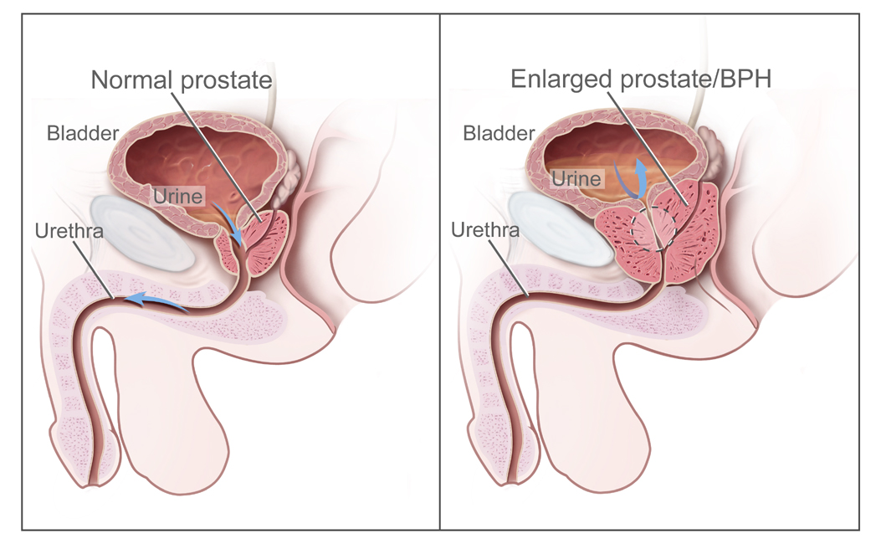
Background
20m Men
>50% over 50
>80% over 80
Not a matter of if, but when

Slide 5
Symptoms of BPH: LUTS
Urinary Frequency
Sudden Urge to Urinate
Frequent nighttime urination
Weak Stream
Feeling as if bladder is not empty
Complications included weakened bladder, bladder stones, recurrent infections, urinary blockage.

Slide 6
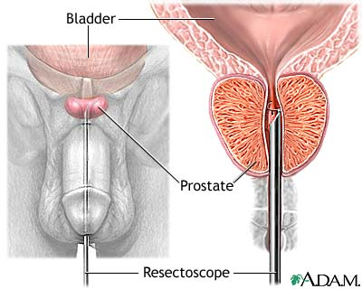
Rationale for new therapy
Risks for standard procedure such as TURP, laser or microwave include:
Impotence
Urine leak or Incontinence
Bleeding
Pain and Stricture/Narrowing
Infection
2m men avoided therapy

Slide 7
Minimally Invasive Therapy Interventional Radiologists

Slide 9
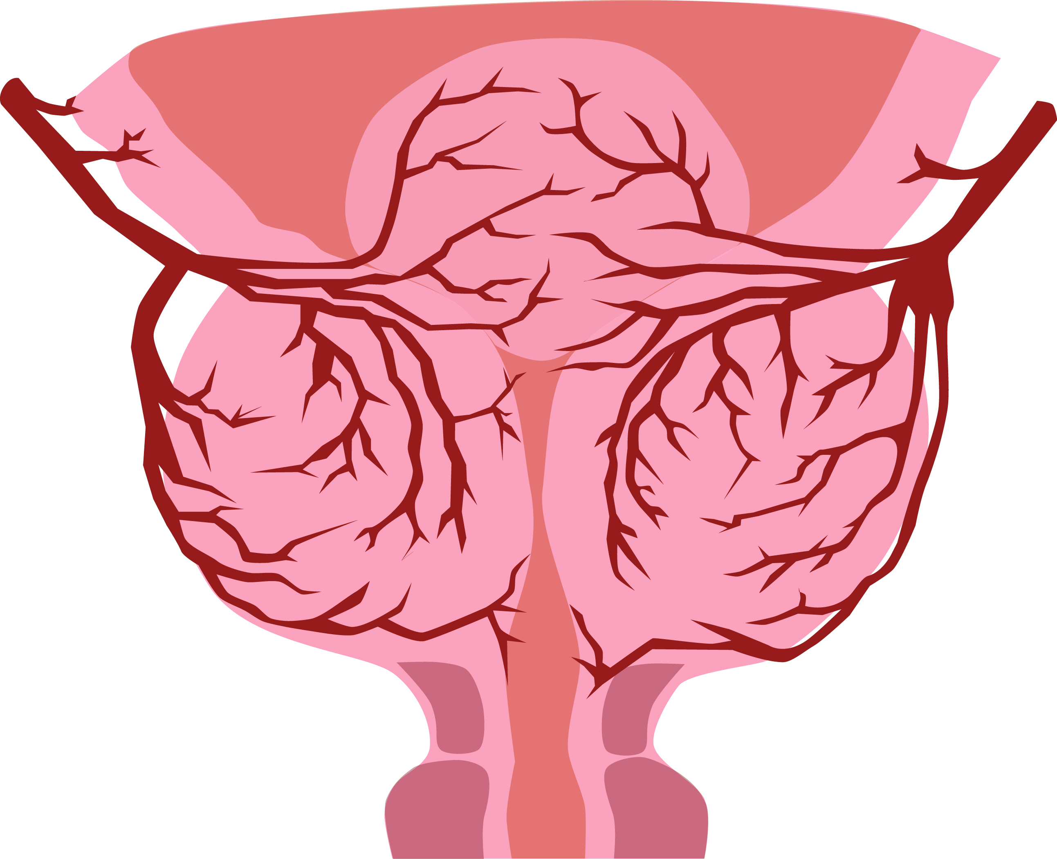
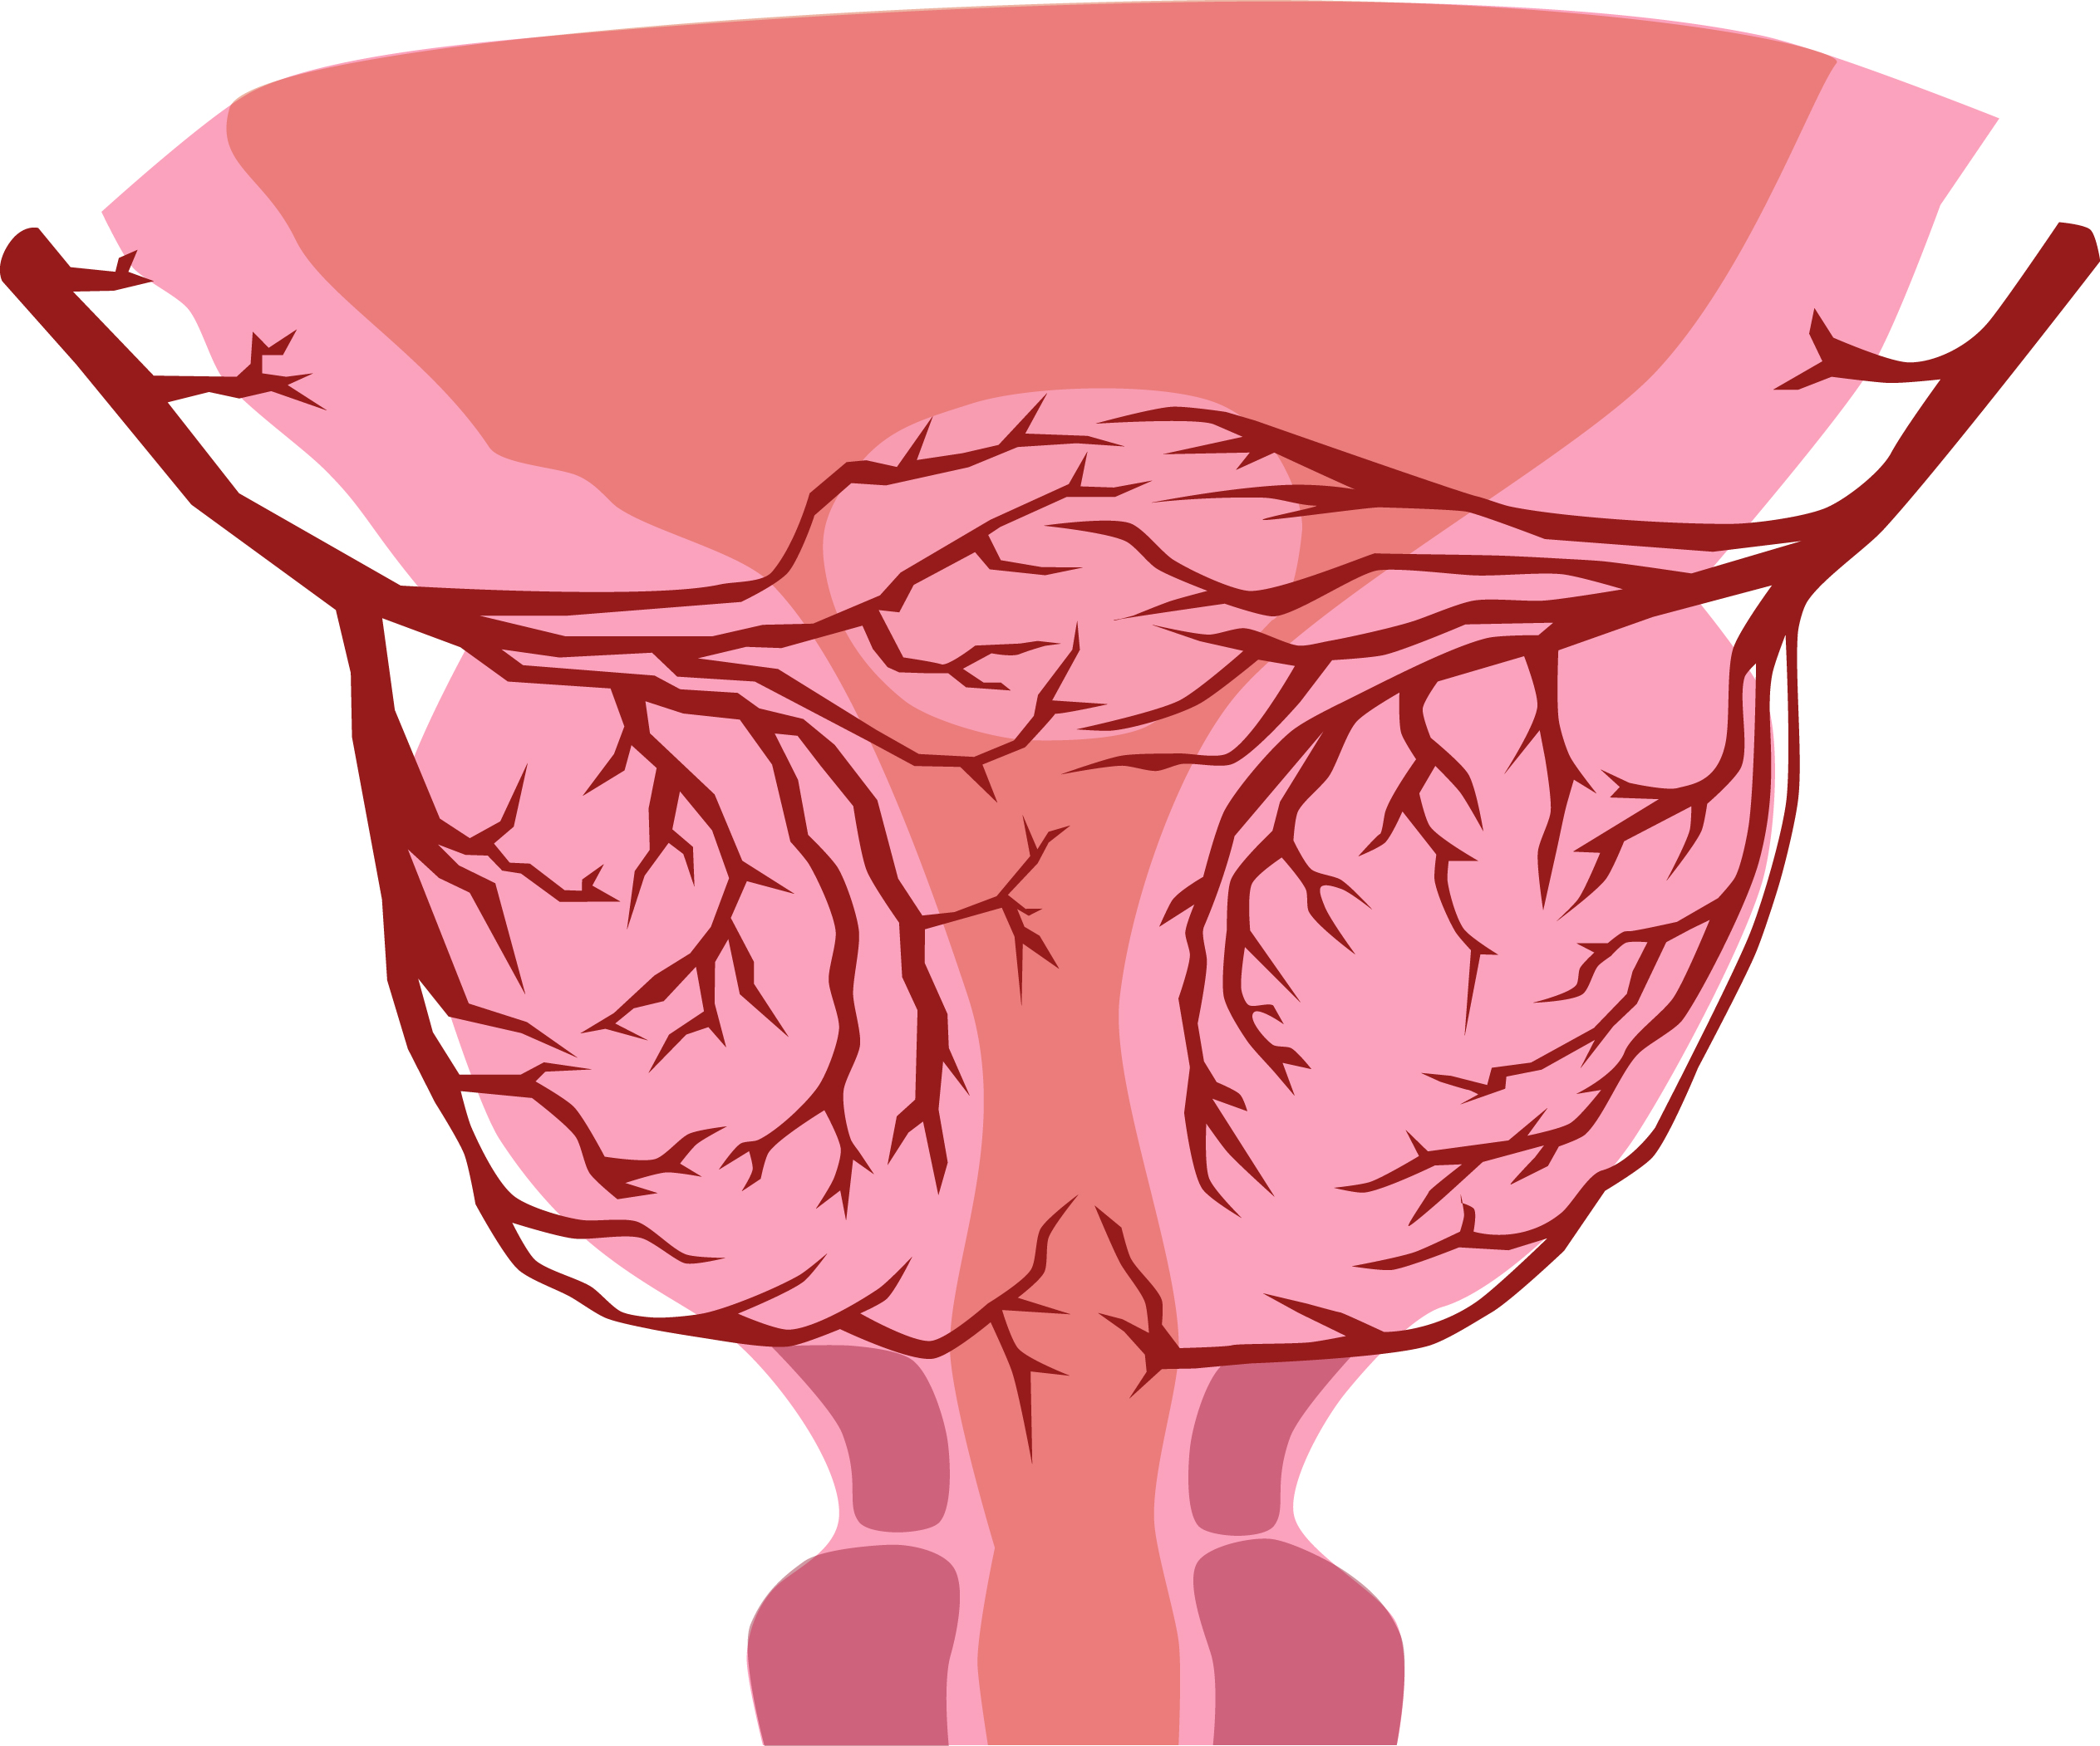
Before
After

Slide 10
Study
Enrolled 30 patients > 50 yrs old
Moderate or Severe Symptoms of BPH
Follow the patients for 2 years and assess for safety and measure the response to treatment
21/30 patients have been treated so far

Slide 11
Demographics
Mean Age: 67 years old
Average AUA Score: 25.2
Mean Quality of Life Score 5.7
Average Prostate Volume: 77 cc

Slide 12
Clinical Results (n=18)
94% of patients had a significant decrease in symptoms from an enlarged prostate
Quality of Life significantly improved in just 4 weeks
Some men stopped prostate related medication altogether.

Slide 13
Safety Results
No Minor or Major Complications
No Urologic Complications including
Impotence
Bleeding
Infection
Urine Leak/Incontinence

Slide 14
Long Term Outlook
PAE works in reducing symptoms, improving QoL and is safe
It can potentially eliminate the need for daily medications
Patients will be followed for two years to assess for long term results
Overseas results from 1-3 year followup are promising.
Future trials comparing to other therapies are planned

