Slide 1
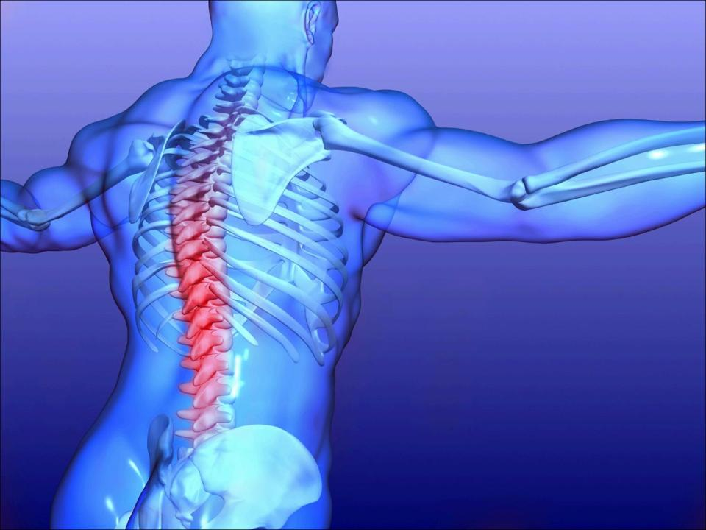
Interventional
Stem Cell Therapy
J. David Prologo, MD
Division of Vascular and Interventional Radiology
University Hospitals Case Medical Center
Cleveland, Ohio

Slide 2
Disclosures

Slide 3
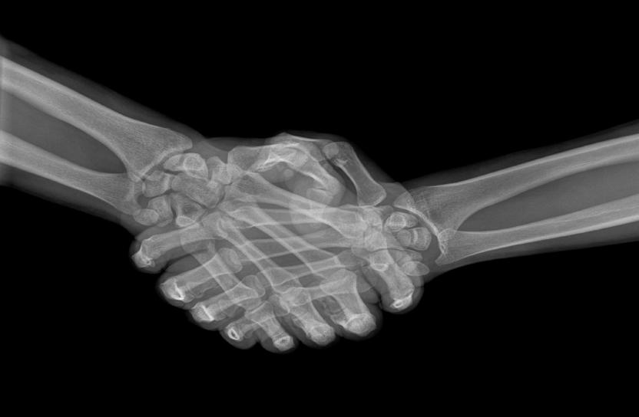
Stem Cell Therapy
MSC Biology
Precision Delivery

Slide 4

Mesenchymal Stem Cells
May be isolated and expanded from the bone marrow, fat, etc.
Are immunologically privileged
Are capable of multilineage differentiation and self-renewal
Have shown promise as regnerative therapy in several settings

Slide 5
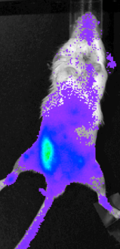
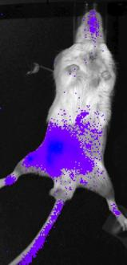
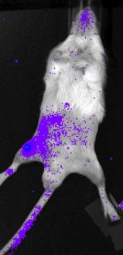
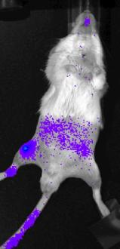
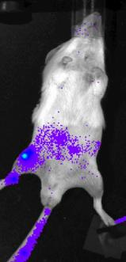
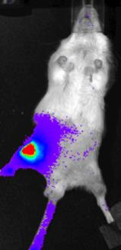
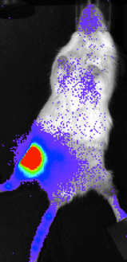
Day 1
Day 2
Day 3
Paul Lin, BS
Arnold Caplan, PhD
CWRU, Cleveland OH
Wk 1
Wk 2
Wk 3
Wk 6
Notes:
5/28/2010
All same scale, seen this with about 20mice now.

Slide 6
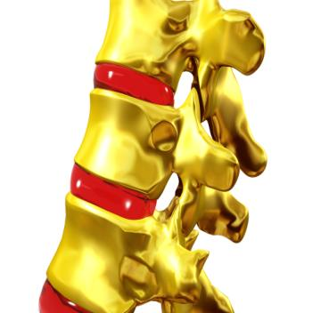

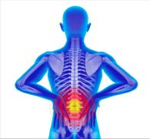
DDD
Prevalence of discogenic degeneration on MR is >80% in pts > 60y, and increases with age
Imaging findings can be employed to predict concordance on discography
Current standard of care is surgery, with associated costs and morbidity
Minimally invasive, needle delivery of effective therapy

Slide 7
DDD
Prevalence of discogenic degeneration on MR is >80% in pts > 60y, and increases with age
Imaging findings can be employed to predict concordance on discography
Current standard of care is surgery, with associated costs and morbidity
Minimally invasive, needle delivery of effective therapy

Slide 8
DDD
Prevalence of discogenic degeneration on MR is >80% in pts > 60y, and increases with age
Imaging findings can be employed to predict concordance on discography
Current standard of care is surgery, with associated costs and morbidity
Minimally invasive, needle delivery of effective therapy

Slide 9
DDD
Prevalence of discogenic degeneration on MR is >80% in pts > 60y, and increases with age
Imaging findings can be employed to predict concordance on discography
Current standard of care is surgery, with associated costs and morbidity
Minimally invasive, needle delivery of effective therapy

Slide 10
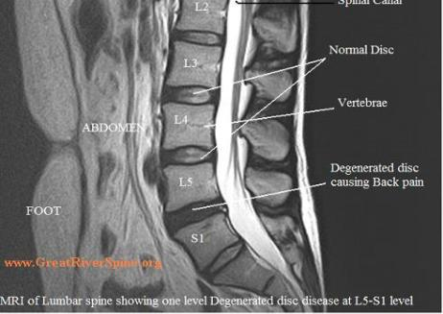
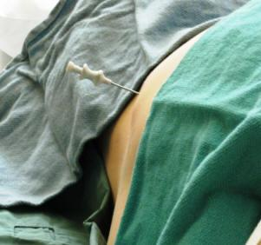

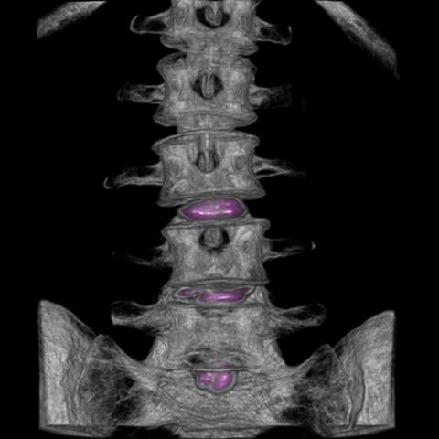
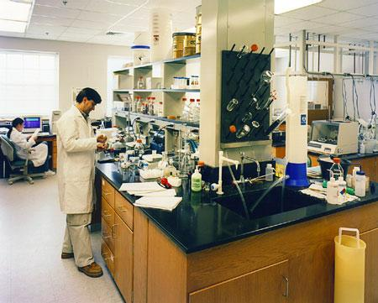
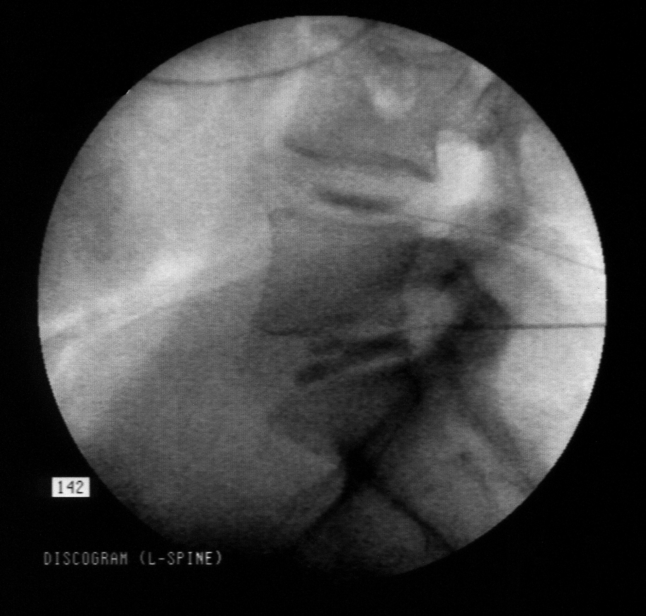
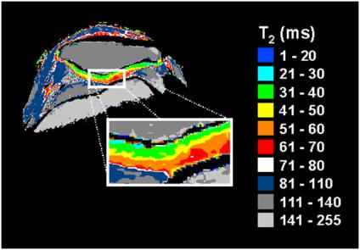


Slide 11
Background (MSCs)
Crevensten et. al.
  in rats, injected BM derived MSCs to the coccygeal discs. 28 days post injection, cells viable localized to discs. Increased disc height on X-ray.
Sakai et. al.
  In rabbits, injected labelled MSCs to injured IVDs. At 2,4, and 8 weeks, showed increases of transplanted cells, differentiation, and IVD matrix intergrity.
Sakai et al.
  In adult rabbits, injected cells to injured IVDs. Showed presence of transplanted MSCs in the IVDs to 48 weeks, with associated increase of proteoglycan content when compared to degenerated controls.
Zhang et al.
  in young rabbits with induced degenerated IVDs, tx’d cells localized to the nucleus. Showed presence of cells, increased ECM, and matrix gene production to 6 months.

Slide 12
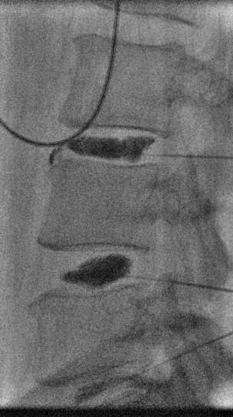
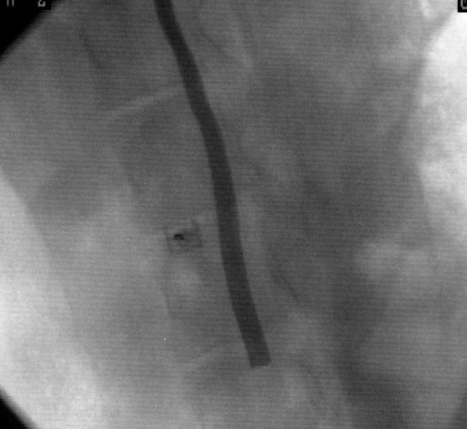
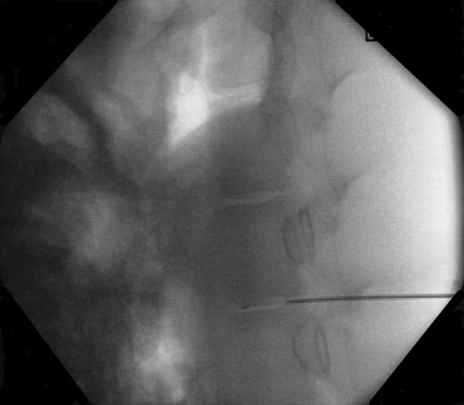
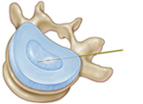
[¹²⁴l]-FIAU labeled reporter transduced hMSCs (200,000)

Slide 13
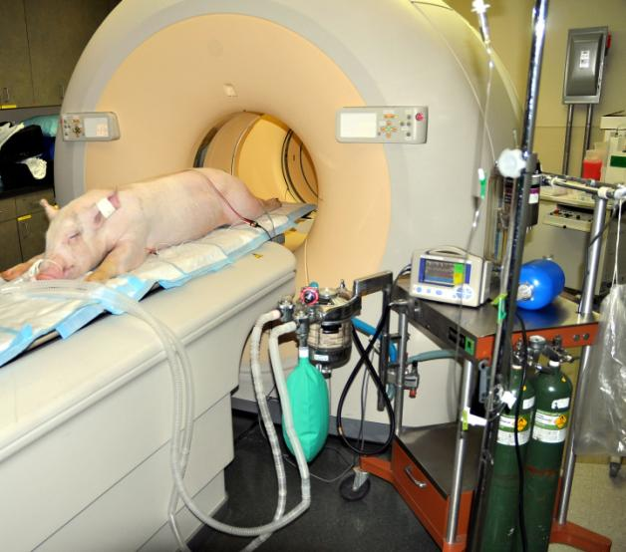

Slide 14
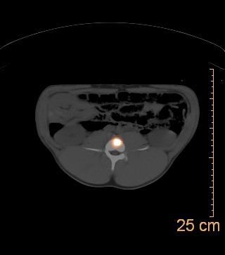
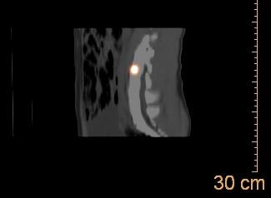
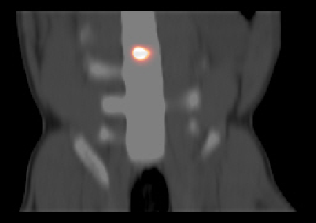
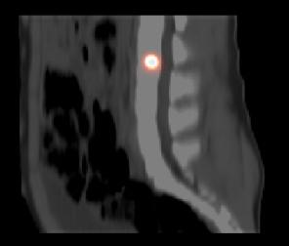
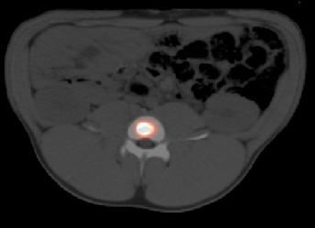
S/P Xenogenic Radiolabled MSC transplantation

Slide 15
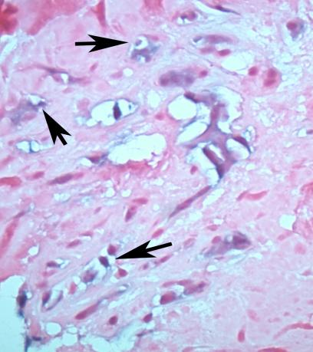
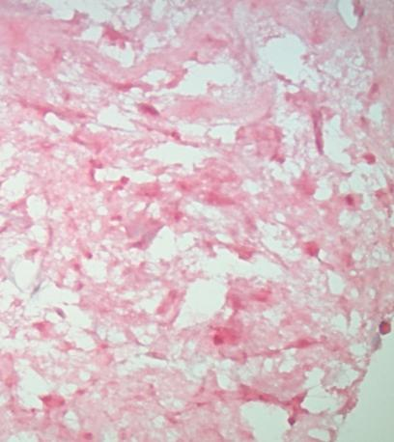
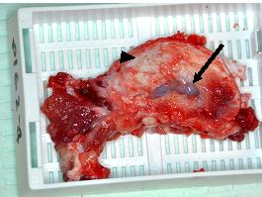
Histology

Slide 16


Slide 17
Preclinical Studies
Accuracy and Containment
  Injection as per established techniques to porcine models of DDD
  Reporter gene imaging to 3 months with PET
  Histological confirmation via ALU stains
ECM repletion
  Quantitative MRI
  Biochemical (gene expression measurments [RNA] -GADPH, Type I collagen, Type II collagen, and Aggrecan) and immunohistochemical (1º atb stains v. HIF-1α, GLUT-1, and MMP-2) correlative studies

Slide 18
Clinical Protocol
IND 14924
Safety
  Safety
    Delivery
    Clinical disability indices
Efficacy
  Efficacy
    Delivery
    Validated Pain Scales (BPI), Quantitative MRI
    Validated Disability Inquiry (Oswestry Disability Index)
    34 patients (17 in each arm [power = 80%])

Slide 19
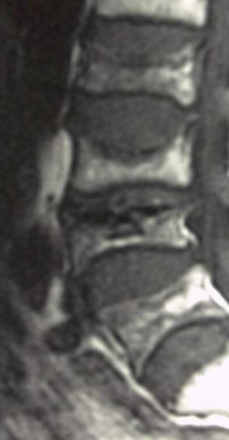

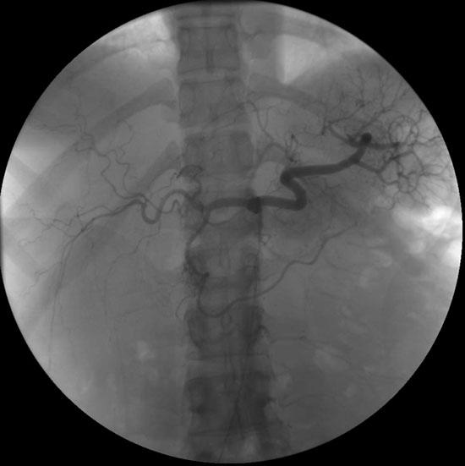
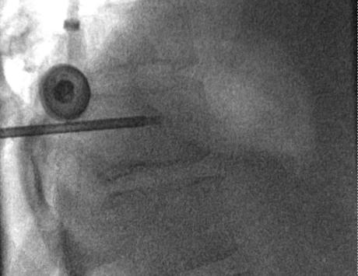
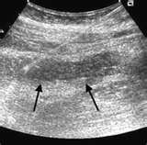

Slide 20

Thank You
Thank You
Zhenghong Lee, PhD
David Corn, BS
Lewis Yuan, BS
Nathan Tenley, BS
Pablo Ros, MD, MPH, PhD
Mark Robbin, MD
Dan Hsu, MD

