Slide 1
Bariatric embolization: an interventional radiologic treatment for obesity
Ben E. Paxton M.D., Aravind Arepally M.D., Charles Y. Kim, M.D.
Charles Y. Kim, M.D.
Assistant Professor of Radiology
Division of Vascular and Interventional Radiology
Duke University Medical Center

Slide 2
Obesity
An epidemic?
2008: 1.5 billion overweight; 500 million obese
Major risk factor for diabetes, heart attacks, stroke, cancer, osteoarthritis
  Increases risk of diabetes 18-fold
Fifth leading risk for death globally
Ex. 25 yr old morbidly obese loses 12 yrs
Buchwald H et al. JAMA 2004
Olshansky SJ. New England Journal of Medicine 2005.

Slide 3
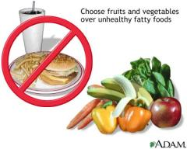

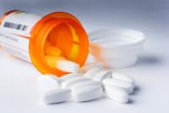
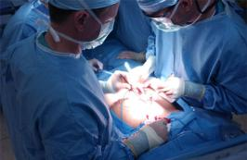
What can be done?
Diet / exercise
  Difficult to sustain
Medications
  Average wt loss: 6-10lbs
Surgery…
Aronne LJ et al. Am J Med 2009

Slide 4
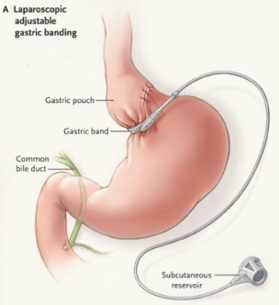
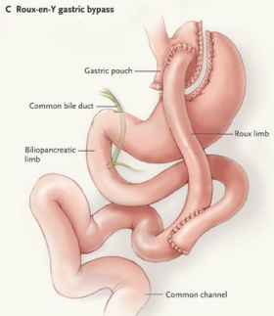
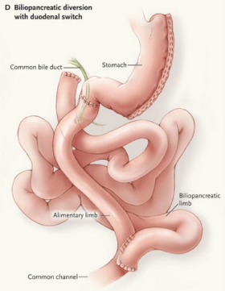
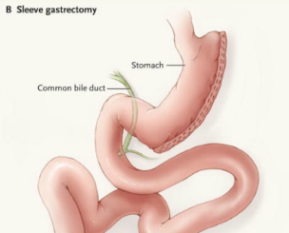
Bariatric surgery

Slide 5
Bariatric surgery: the good
Average weight loss: 88 lbs (sustained)
Diabetes: 77% resolved
Hypertension: 62% resolved
Sleep apnea: 86%
Hypercholesterolemia: 87% improved
Effects of obesity…
Buchwald H et al. JAMA 2004.

Slide 6
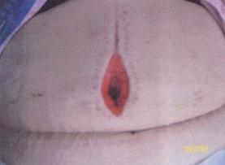
Bariatric surgery: the bad
Major Abdominal Surgery
Mortality: 1-2%
Wound complications: 7%
Hernias: 9%
Esp high risk:
  Extreme obesity
  Co-existing medical conditions
Need an alternative for surgery!
DeMaria EJ. New England Journal of Medicine 2007.
Crookes PF. Ann Rev Med 2006.

Slide 7
What is embolization?
“embolization” : obstruction of a blood vessel
Common tool for interventional radiologists
  Stop life-threatening hemorrhage
  Treat tumors
Performed through a ‘needle hole’ in the body

Slide 8
What is Ghrelin
The “Hunger” hormone
  THE most potent appetite stimulant
90% produced in the stomach fundus
Levels rise before meals
Levels fall after eating
Levels increase with dieting
*Ghrelin is a key target for weight control

Slide 9

“Bariatric embolization”
Pioneered by Aravind Arepally MD, interventional radiologist
Concept: Interventional radiologists can destroy cells by blocking the blood supply
Most ghrelin secreting cells in the fundus
Interventional radiologists are experts at finding and targeting specific arteries
Fundus
* can we destroy ghrelin-secreting cells by blocking its blood supply?

Slide 10

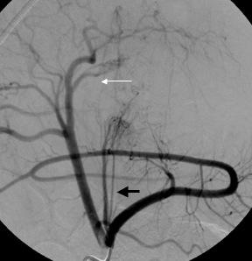
Experimental study: Bariatric Embolization
Duke University Medical Center
Ben Paxton MD, Aravind Arepally MD, Charles Kim MD
Funded by resident grants to Dr. Paxton
  S.I.R, R.S.N.A.
12 pigs
  6: bariatric embolization
  6: untreated

Slide 11
Ghrelin levels after bariatric embolization
(relative to untreated animals)
Difference in Ghrelin levels
Week 4
Week 7
untreated
Bariatric embolization

Slide 12
Weight change after bariatric embolization
(relative to untreated animals)
% wt gain
Week 4
Week 7
untreated
% wt loss
Bariatric embolization

Slide 13
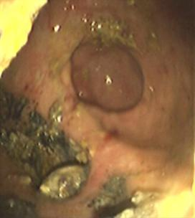
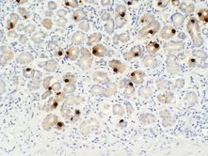
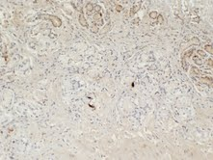
Endoscopy and stomach analysis
*No evidence of tissue death
No perforations (holes)
Ulcers in 2/6
Drastically decreased numbers of ghrelin-producing cells
Nontreated Bariatric embolization

Slide 14
Conclusions
*Starving the stomach of its blood supply decreases ghrelin, which decreases hunger
*Performed through a needle hole
*No evidence of dangerous stomach destruction
FDA cleared devices
Ulcers in 33% of treated → need to refine technique / adjunct medications
Nearing clinical trials in humans
  Potential adjunct or alternative to surgery?

