Slide 1
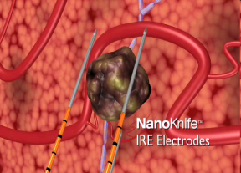
DOWNSTAGING LOCALLY ADVANCED PANCREATIC ADENOCARCINOMA (LAPC) WITH VASCULAR ENCASEMENT USING PERCUTANEOUS IRREVERSIBLE ELECTROPORATION (IRE)
NARAYANAN,GOVINDARAJAN; ARORA,GEETIKA;
BARBERY, KATUSKA;FROUD,TATIANA;LIVINGSTONE,ALAN;
FRANCESCHI,DIDO; HOSEIN,PETER;
ROCHA LIMA,CAIO;YRIZARRY,JOSE

Slide 2
PANCREATIC CANCER
American Cancer Society. Cancer Facts & Figures 2011. Atlanta: American Cancer Society 2011.
American Cancer Society. Cancer Facts & Figures 2011. Atlanta: American Cancer Society 2011.
American Cancer Society. Cancer Facts & Figures 2011. Atlanta: American Cancer Society 2011.
American Cancer Society. Cancer Facts & Figures 2011. Atlanta: American Cancer Society 2011.
American Cancer Society. Cancer Facts & Figures 2011. Atlanta: American Cancer Society 2011.
5-year survival rate of 6%
Case-fatality rate among the highest of any malignancy
Surgical resection offers the best chance for cure, but only 10%-20% of patients will qualify
Notes:
American Cancer Society estimates 43,920 people will be diagnosed with pancreatic cancer and approx. 37,390 people will die of the disease this year

Slide 3
WHAT IS LOCALLY ADVANCED PANCREATIC CANCER (LAPC)?
Pancreatic cancer that has not spread to distant organs (Non-metastatic disease) but is inoperable due to encasement of major blood vessels.
Notes:
Approx. 40% of newly diagnosed pts present:
LAPC pts have a better survival than those with metastatic disease but overall outcome is still poor
1/3 pts who initially have LAPC may become resectable after neoadjuvant therapy

Slide 4
CURRENT TREATMENT OPTIONS
Surgery
Chemotherapy
Radiation therapy

Slide 5
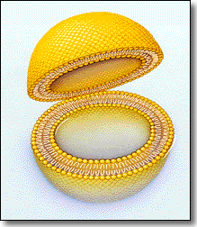
WHAT IS IRREVERSIBLE ELECTROPORATION (IRE)?
A focal ablation therapy that uses high voltage low energy DC electrical pulses to permanently open pores in the cell membranes of soft tissue, which causes cells to die.
Notes:
IRE guides electrode needles into the tumor, sends electrical pulses to force open and destroy tumor cells around a delicate network of blood vessels

Slide 6
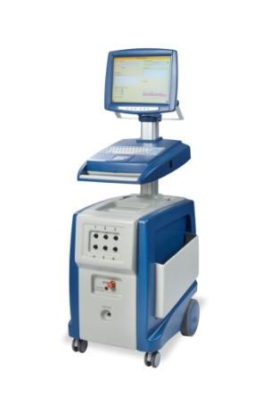
NANOKNIFE GENERATOR
Has a 510(k) clearance from the FDA for soft tissue ablation
Use in organs is considered off-label

Slide 7
THERMAL ABLATION OPTIONS
RADIO FREQUENCY ABLATION
MICROWAVE ABLATION

Slide 8
PURPOSE OF THE STUDY
Safety of IRE in treating Pancreatic Cancer without open surgery with imaging guidance
Resection rate in LAPC after using IRE

Slide 9
TREATMENT CRITERIA
Patients who failed previous chemotherapy and radiation treatment
Patients with unresectable pancreatic tumors
Patients with minimal and stable metastatic disease

Slide 10
RECENT ANALYSIS
8 patients treated between 12/2010 – 9/2011
Most patients had received prior chemotherapy and or radiation
Median time between diagnosis and IRE: 9 months
2 went to surgery. Both had successful resections and remain cancer-free. ( 346 and 225 days post surgery)

Slide 11
WHY THIS MATTERS TO PATIENTS?
A new option, with potential ability to down stage
Minimal side effects and morbidity
Other treatment options can still be used
Notes:
Heat based techniques have been tried without much success
Has remained a surgical procedure with signifcant risks

Slide 12
PANCREAS IRE CASE
65yr old female
Biopsy proven pancreatic cancer
Received Chemotherapy and radiation
Inoperable due to vessel encasement and residual disease

Slide 13
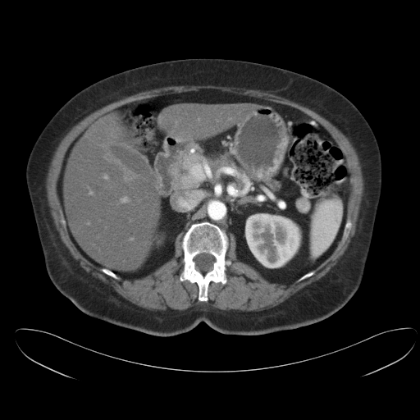
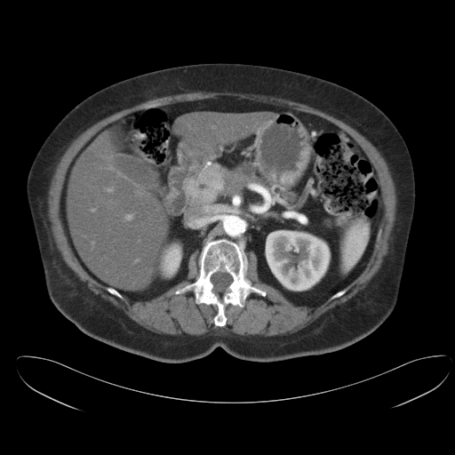
PRE IRE CT
Tumor after chemotherapy and radiation therapy
Celiac axis and SMA encasement

Slide 14
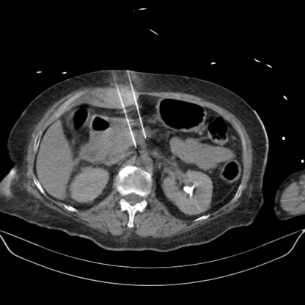
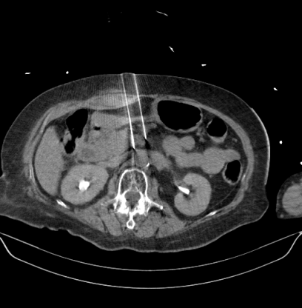
11/10- ELECTRODE PLACEMENT UNDER CAT SCAN GUIDANCE
IRE probe placement

Slide 15
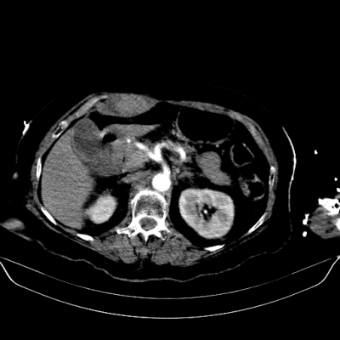
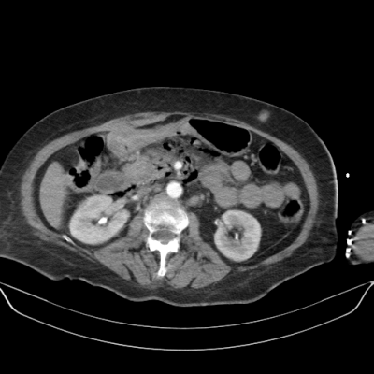
IMMEDIATE POST CT SCAN
Unaffected vessels and air surrounding the treatment zone

Slide 16
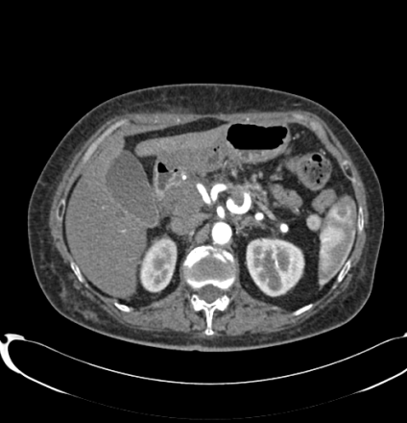
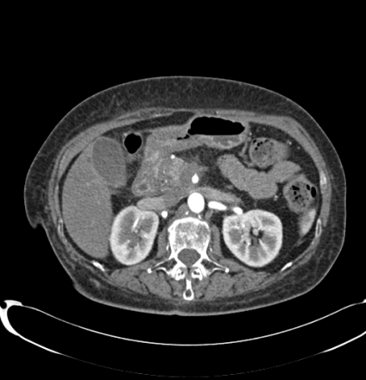
FOLLOW UP CT 3/11
Vessel encasement

Slide 17
SURGERY 4/11
Tumor involved body & neck
Distal Pancreatectomy & Splenectomy
Proximal pancreatic margin frozen sample- Negative

Slide 18
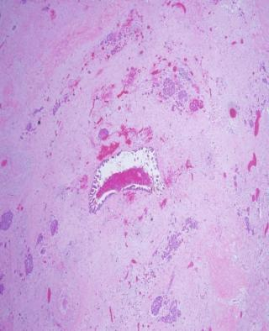
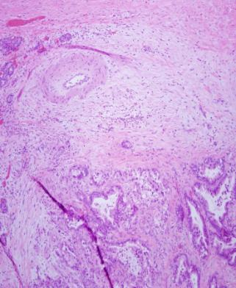
PATHOLOGY
Extensive fibrosis
Residual Intraductal Mucinous Ca

Slide 19
FOLLOW UP
Follow up days: 421
CT :1/24/2012: No enhancing mass- No evidence of Disease
Disease status: Stable
CA-19-9: Decreasing trend from 24.2 to 15.8
Notes:
Patient will be seen in 4 months

Slide 20
What we know & Where we go from here
Can be done safely with imaging guidance.
Early results in a small number of patients is promising
Trial to validate these results

Slide 21
Thank You

