Slide 1
Aggressive Management of Chronic Deep Venous Thrombosis:
Technical and Clinical Outcomes
Mark J. Garcia M.D. FSIR
C Grilli, M McGarry, M Ali, D Agriantonus, S Goodman, J Lee, C Wrigley, D Thompson, D Leung, G Kimbiris, M Horvath
Vascular & Interventional Radiology
Christiana Care Health Services
Newark, DE

Slide 2
Background
Deep venous thrombosis (DVT)
  500,000-600,000 new cases in US annually¹
  40-60% of pts on anticoagulation will develop PTS after 1st episode of DVT²
Post thrombotic syndrome (PTS)
  clinical complication of DVT can be lifestyle limiting and debilitating
  Sx: pain, edema, varicosities, skin discoloration, thickening & ulceration
  500,000-600,000 venous ulcers yearly³
Estimated socioeconomic burden of $ 3 billion annually⁴

Slide 3
Background
Standard tx of anticoagulation:
elastic compression stockings (ECS) ……..
often not sufficient

Slide 4
Purpose
Evaluate the safety and efficacy of treating pts with chronic DVT & PTS
Report early & midterm results on patency & symptomatic improvement

Slide 5
Demographics
Retrospective, single center case reviews
106 patients and 122 limbs treated
  66 M, 40 F
  Mean age 57; range 13-96 years old
  17 upper and 105 lower extremities
  IVC involvement in 25 (24%)
Documented DVT by US
All patients had symptoms > 1mo
DVT defined as chronic by age of sx onset > 1mo
All with varying degrees of PTS symptoms:
  Pain & swelling ➔ ulcer & gangrene ( > CEAP 3)
  All c/o lifestyle limitations

Slide 6
Methods
Case review data was collected including:
  DVT history
  Procedural information
  Immediate technical outcomes
  Symptomatic improvement
  Ultrasound follow-up at 1,3,6, and 12 months, and yearly thereafter

Slide 7
Methods
Minimally Invasive endovascular techniques included:
  Initial PTA
  Lysis +/- US assisted (EKOS)
  PCBs
  Adjunctive therapies
    Stenting, PMT
  Anticoagulation
  ECS

Slide 8

Tests your skills….

Slide 9
Results
Technical success defined as:
Ability to cross vein occlusion
120/122
B) Ability to restore flow
118/122

Slide 10
Results
Clinical success defined as:
Symptomatic improvement
US Patency (persistent flow)

Slide 11
Results
Symptomatic Improvement
  Mean follow-up: 2 yrs 7 mo
  104 of 122 limbs:
    97 (93%) reported significant improvement
    7 (7%) unchanged
    0 worse
    18 were lost to follow-up

Slide 12
Results
US Patency ( % Remaining open)
  1 mo: 95 of 100 (95%)
  3 mos: 71of 77 (92%)
  6 mos: 57 of 65 (88%)
  12 mos: 30 of 38 (79%)
  24 mos: 11 of 19 (58%)

Slide 13
Example
65 yo F in 1998 had hysterectomy w/ left iliac vein rupture.
Vasc surgeon unable to repair- ligated
Immediately developed pain & swelling
Extensive LLE DVT
Anticoagulation & ECS x yrs
Severe limitations in activity with poor QOL
Referred by VS for eval & management

Slide 14
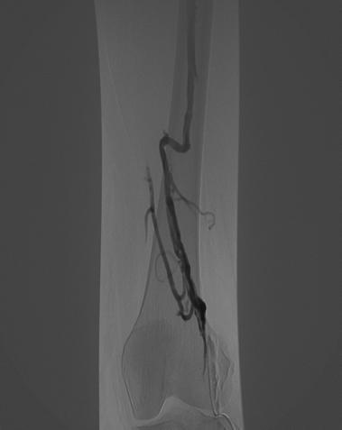
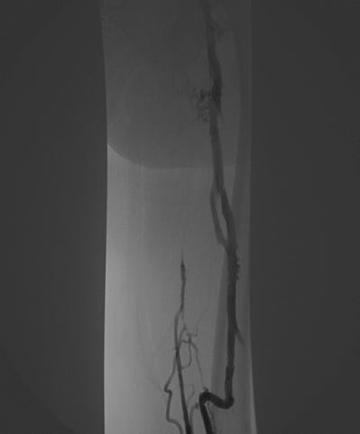
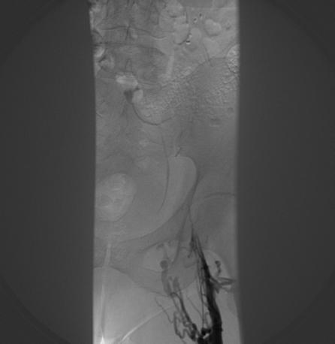
12 yr old DVT

Slide 15
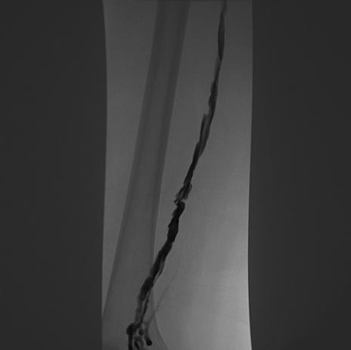
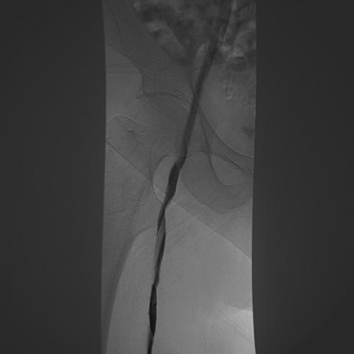
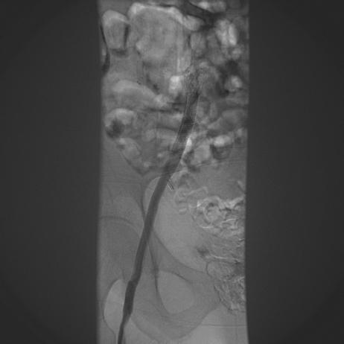
Post Treatment

Slide 16
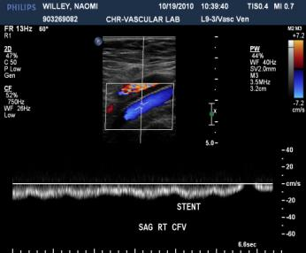
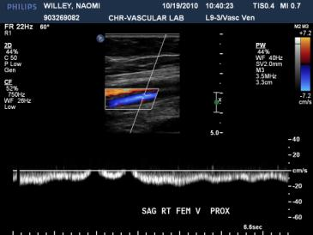
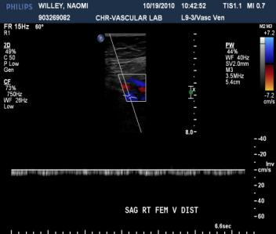
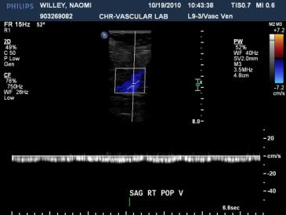
12 Mo. F/U US

Slide 17
18 Mo. F/U
“Extremely happy” w/ result.
Active w/ daily treadmill & cycling
Rare & minimal swelling
No pain
Rx w/ therapeutic anticoagulation x 2 yrs
ECS daily

Slide 18
Conclusion
Chronic, occlusive DVT causing significant quality of life limitations from PTS can safely and effectively be treated with excellent short to mid term technical and clinical outcomes.
Further larger, multi-center, controlled trials would be warranted.

Slide 19
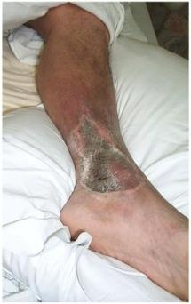
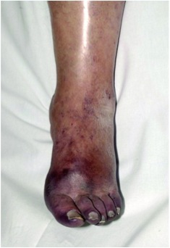
Imagine
Notes:
Imagine a day when these sequelae of DVT no longer exist.

Slide 20
Thank You
magarcia@christianacare.org
302-733-5625

Slide 21
References
1. US surgeon general’s office; 2008.
2. Kahn SR, Shrier I, Julian JA, et al. Determinants and time course of the post-thrombotic syndrome after acute deep venous thrombosis. Ann Intern Med 2008;149:698–707.
3. Pacific Vascular Symposium 6. Kona, Hawaii, 2009.
4. Lazarusetal. Arch Dermotolgy 1994; 130:489-93.

